Slide 1
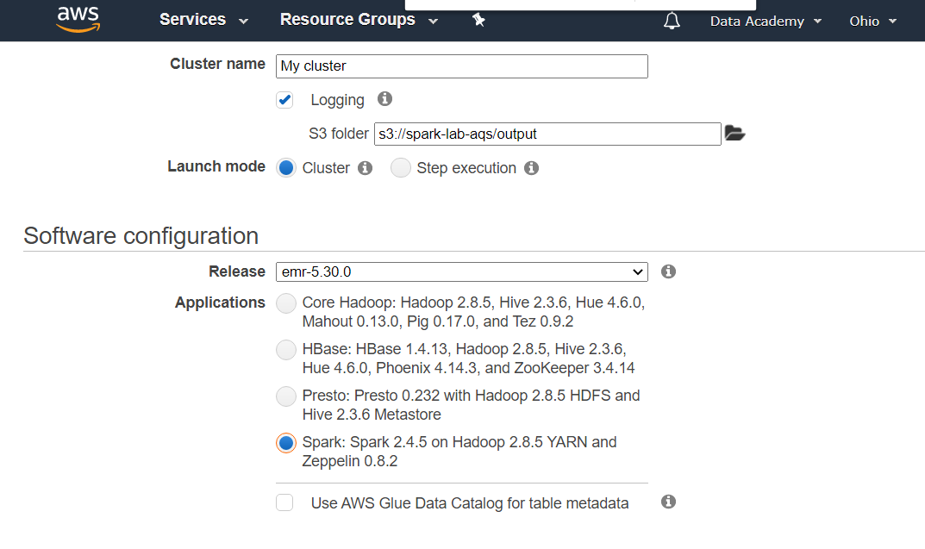

Slide 2
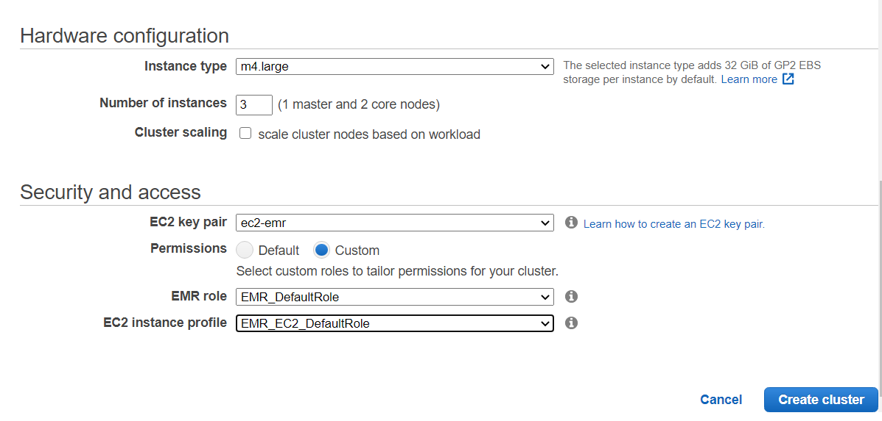

Slide 3
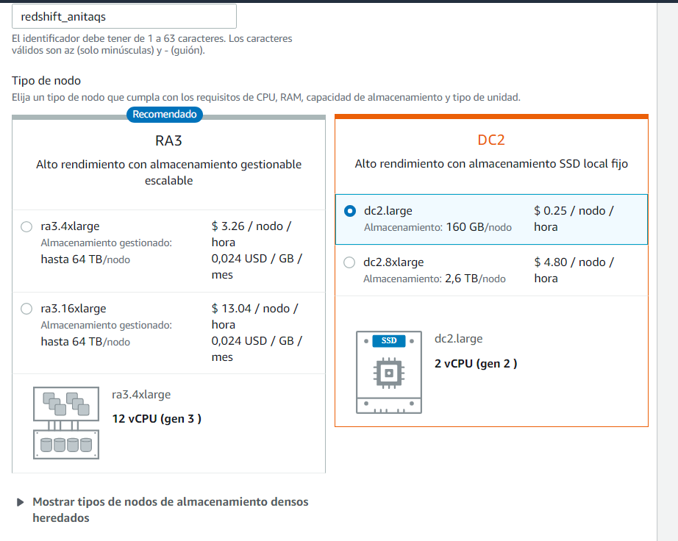

Slide 4
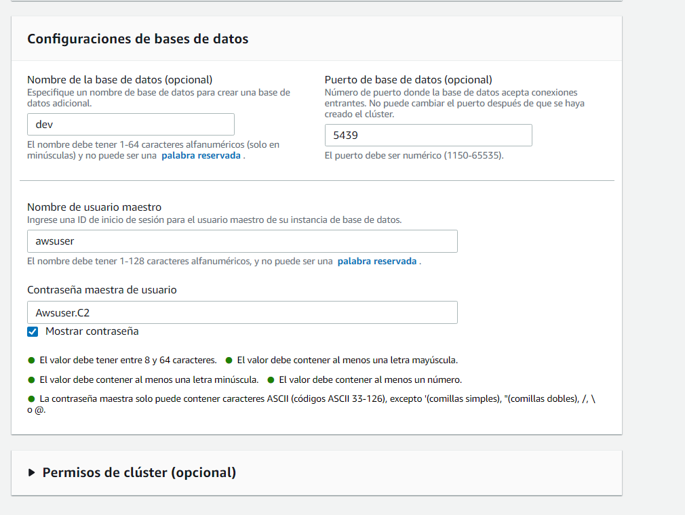
Awsuser.C2

Slide 5
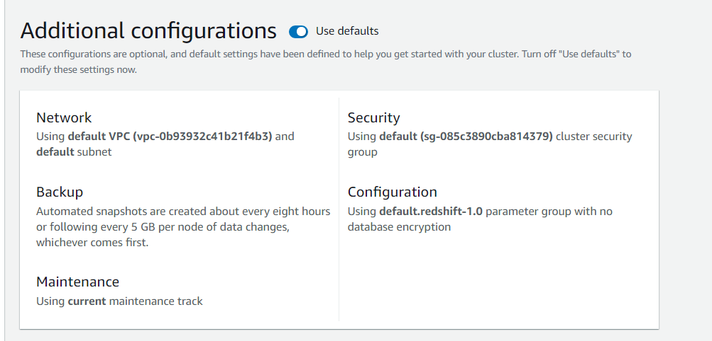

Slide 6
Conectarse a EMR
Chmod 777 ec2-emr.pem
ssh -i ec2-emr.pem hadoop@ec2-18-219-99-58.us-east-2.compute.amazonaws.com
aws s3 cp s3://librerias-spark/ . --recursive

Slide 7
spark-shell --jars minimal-json-0.9.5-SNAPSHOT.jar,/usr/share/aws/redshift/jdbc/RedshiftJDBC.jar,spark-avro_2.11-3.0.1.jar,spark-redshift_2.11-2.0.1.jar

Slide 8
